Slide 1


Slide 2
A2 Chemistry
Precipitation reactions

Slide 3
Review
Ions can be identified by colour of solutions, flame tests and reactions, such as precipitation and acid-base

Slide 4
Learning Intention
the presence of specific ions in solutions can be identified by observing the colour of the solution, flame tests and observing various chemical reactions, including precipitation and acid-base reactions

Slide 5
Success Criteria
Use solubility rules to classify as (aq) or (s)
Use colours of ions and solids to determine observations of precipitation reactions.
Write precipitation reactions (ionic) and observations

Slide 6
Key terms
precipitate
spectator ions

Slide 7
Solubility rules
Solubility rules make generalisations about the solubility of different anions (negative ions), (see p 4 of data booklet) of course there are always exceptions!

Slide 8
Precipitation reactions
Remember that when ionic solids dissolve, their ions dissociate. If a combination of ions are mixed together, a precipitate may form

Slide 9
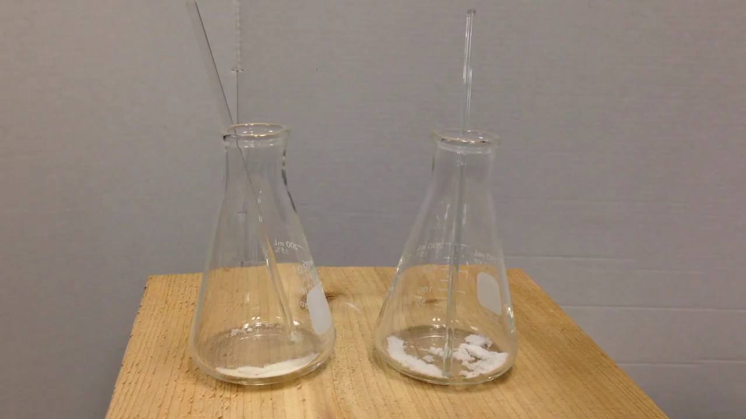

Slide 10
List all the ions present
Swap them to form possible new pairs
Check the solubility of the new pairs using the solubility rules: Insoluble means a precipitate will form.
Write an equation which only includes the ions that form the precipitate.
All other ions are called ‘spectator ions’, they are present but not included in the reaction.
Don’t forget to include states and balance for both atoms and charge.

Slide 11
Observations
Avoid inferences: don’t use names of compounds or words like ‘precipitate’ or ‘dissolves’.
Describe the reactants’ and products’ colour and state (odour for other reaction types)
‘Clear’ is not a colour! Use colourless for solutions and white for solids

Slide 12
eg
sodium carbonate + copper II sulfate

Slide 13
Success Criteria
Use solubility rules to classify as (aq) or (s)
Use colours of ions and solids to determine observations of precipitation reactions.
Write precipitation reactions (ionic) and observations

